Slide 1

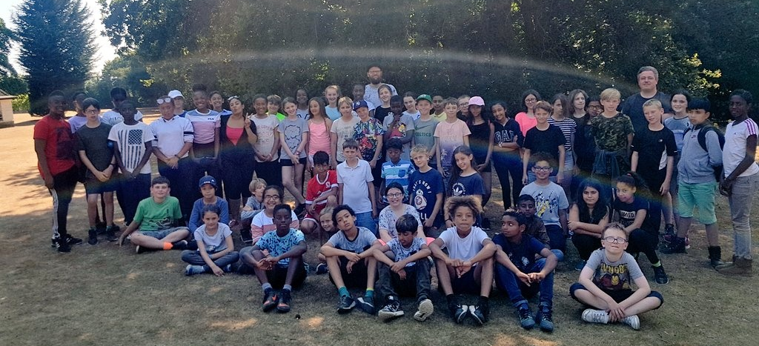
Year 6 Fairplay House
Residential
Maldon
Wednesday 16th - Friday 17th July 2025

Slide 2
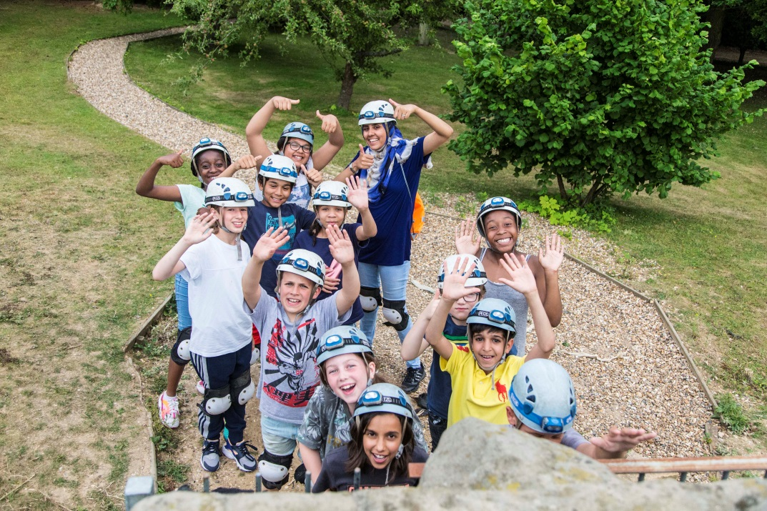


Curiosity, Involvement, Confidence & Independence
Why do we go?

Slide 3

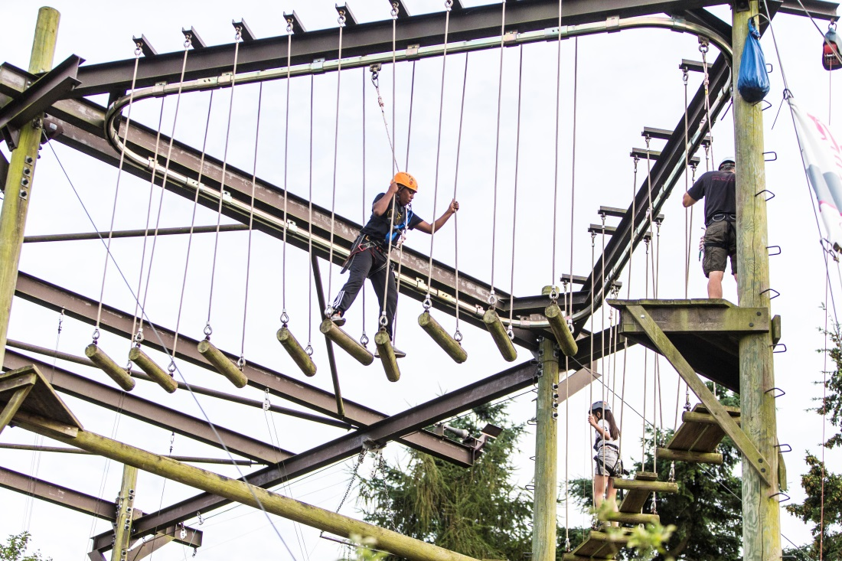
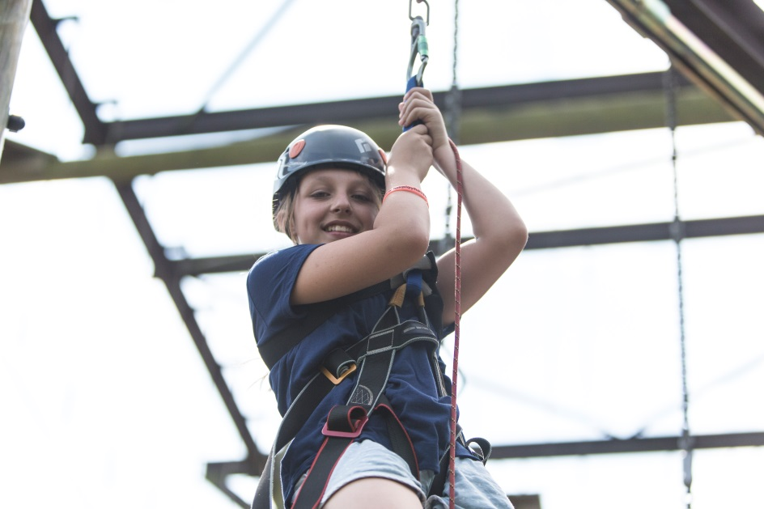
Personal Challenge

Slide 4
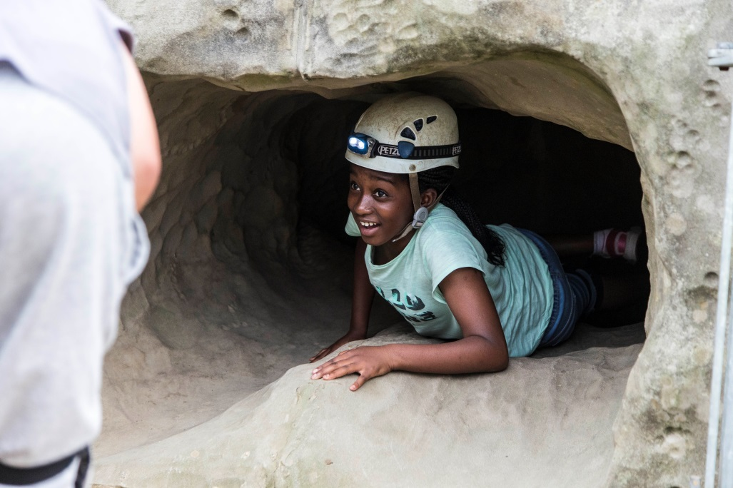
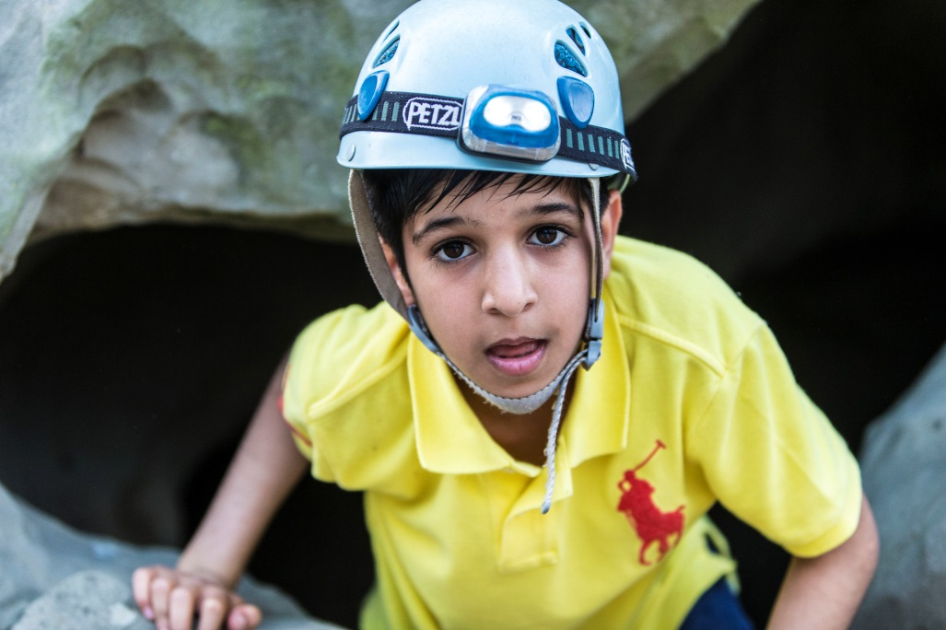
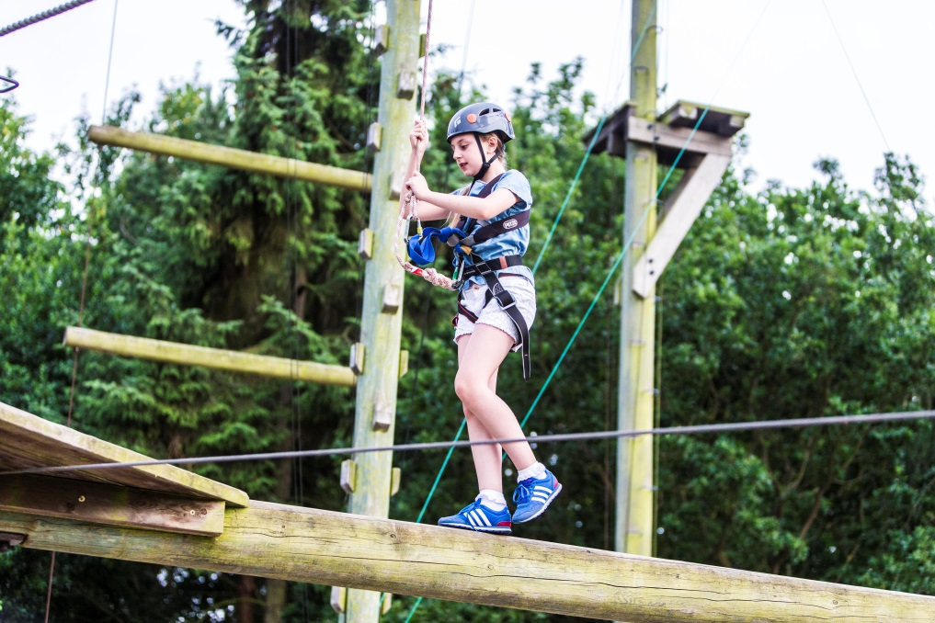
Personal Challenge

Slide 5
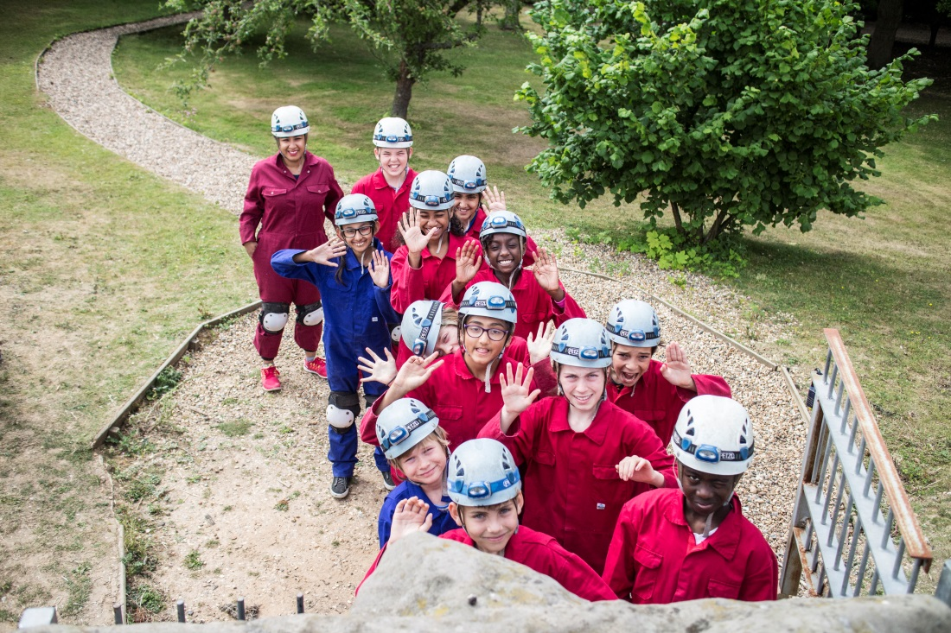
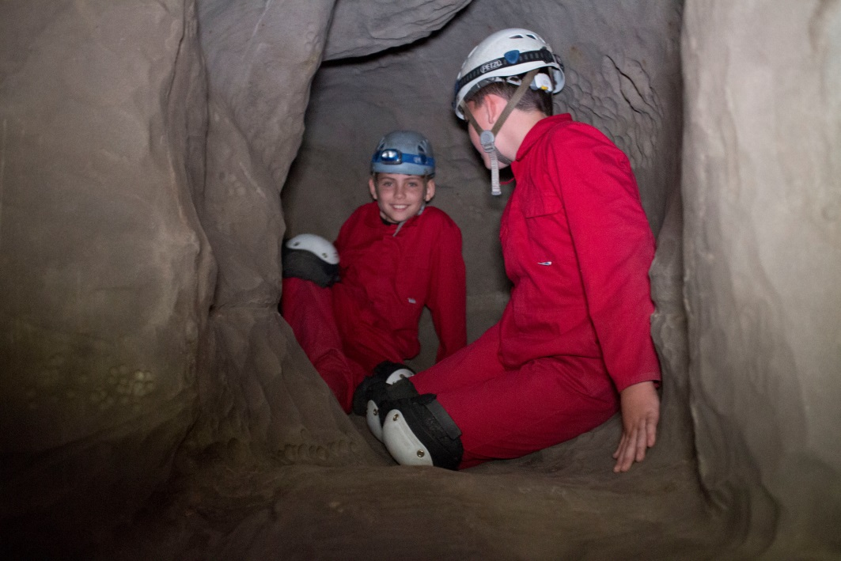
Activities: Caving
The specially constructed caving system allow groups to explore an underground maze of tunnels and caverns and include stalactites, stalagmites, level changes, vertical descents, ascents and squeezes.
The tunnels are designed in inter-linked circuits giving the impression of a much larger cave system. All equipment is provided including boiler suits, knee-pads and helmets equipped with torches which allow individuals to experience caving in a safe yet challenging environment.
Experience: Novice to intermediate.
Benefits: Helps encourage trust and enhances self-confidence and leadership.
Group size: Max 15.
Duration: 2.5 hours.
Equipment: All specialist equipment is provided.

Slide 6
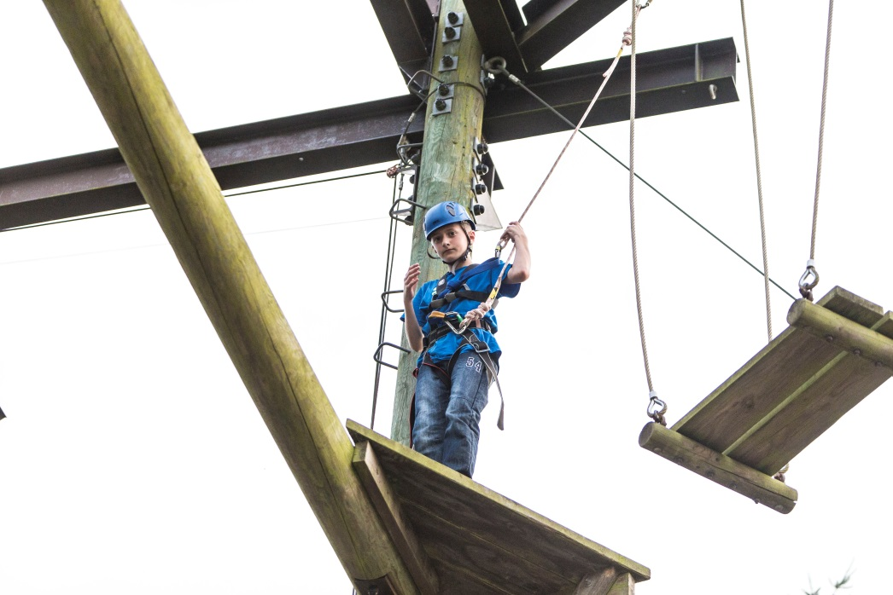
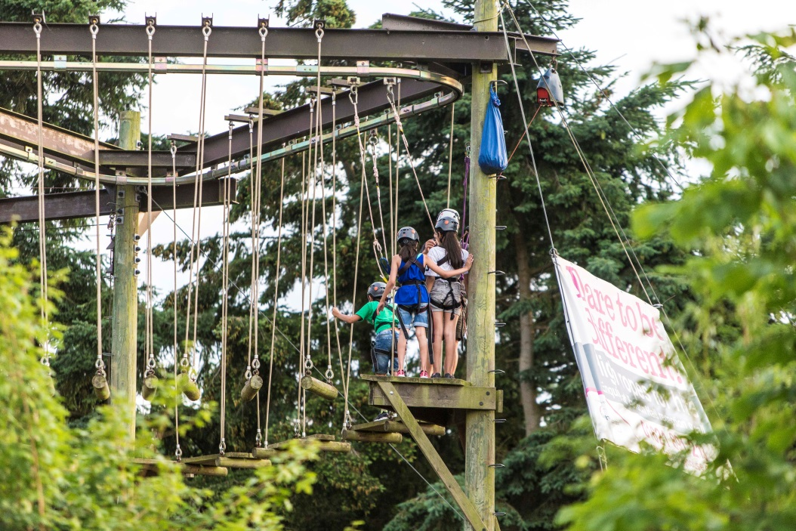
Activities: High Ropes
One of the Centre’s ‘flagship’ activities, the high ropes course never fails to get a group working together. The 13 meter high course is designed to push boundaries around trust and teamwork, and helps to conquer personal challenges.
A typical 2.5 hour session uses up to three of the courses eight challenges which are best suited to the groups needs/abilities.
Experience: Novice to expert.
Benefits: Trust, achievement and enhancing personal development through high adrenaline challenges.
Group size: Max 15.
Duration: 2.5 hours.
Equipment: All specialist equipment is provided.

Slide 7
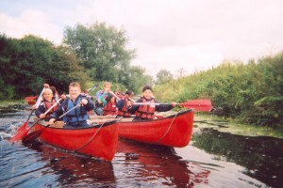
Activities: Canoeing
Rafted canoeing using pairs of open canoes tied together to form a catamaran, virtually uncapsizable, enables us to provide a safe water experience for all ages and abilities. Ideal for non-swimmers, nervous paddlers or individuals with special needs.
1-3 people in each boat (2-6 together in a raft).
Solo canoeing or 2-3 people per canoe are taught more advanced skills allowing for a greater sense of freedom and adventure.
Experience: Novice to intermediate.
Benefits: Teamwork, communication, co-ordination, exploration and adventure.
Group size: 12.
Duration: 2.5 hours.
Equipment: All specialist equipment is provided.

Slide 8
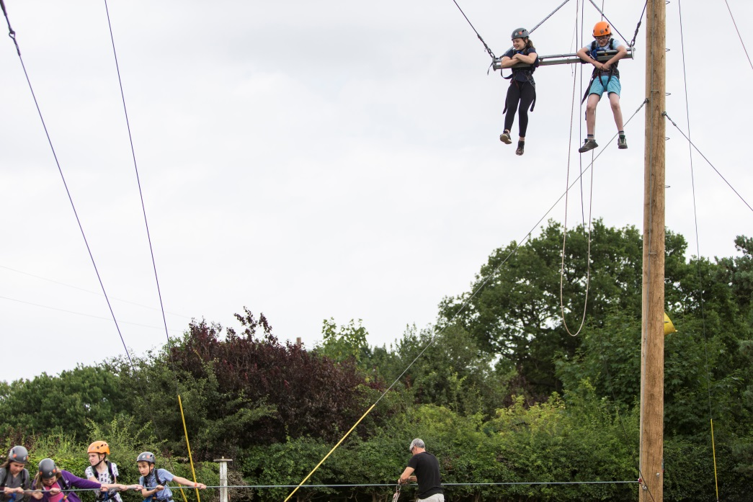
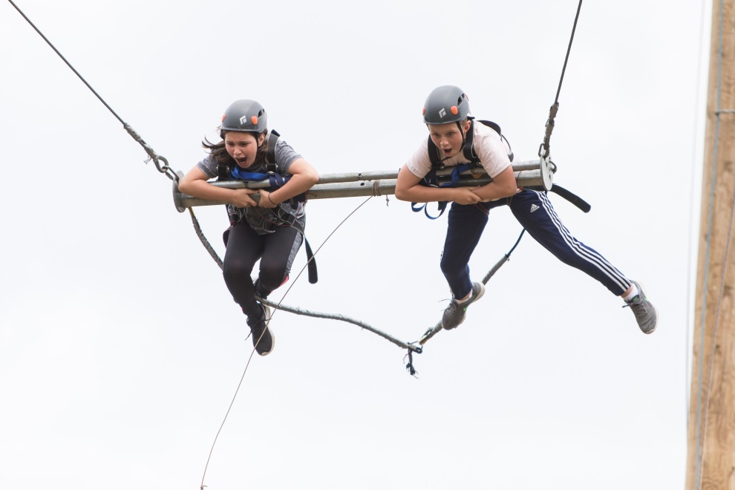
Activities: The Swing
This activity is designed for the group to work as a team. It is designed to push the children's boundaries and overcome any fear.
Experience: Novice to expert.
Benefits: Trust, achievement and enhancing personal development through high adrenaline challenges
Group size: Max 15 including teachers/leaders and instructors.
Duration: 2.5 hours.
Equipment: All specialist equipment is provided.

Slide 9

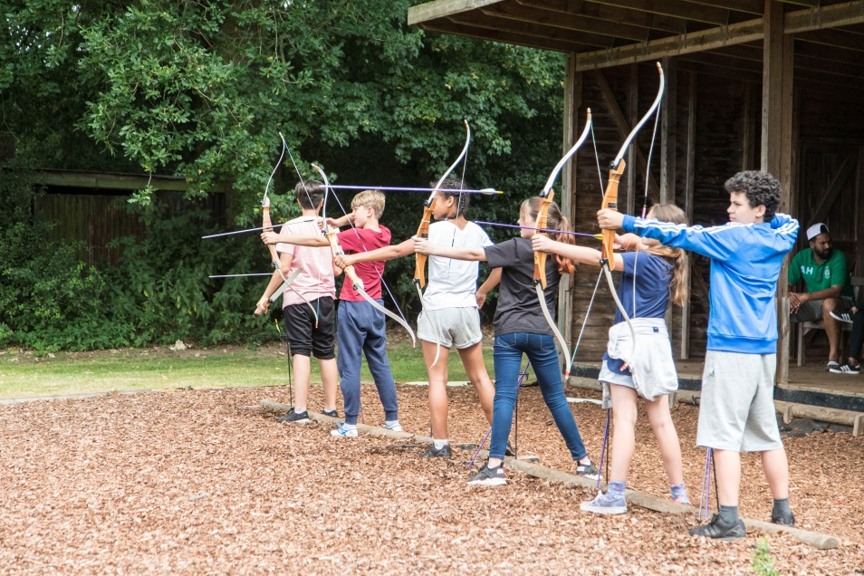
Activities: Archery
Archery which has become an Olympic sport and popular recreational activity, is taught in the grounds of Fairplay House. The professional and experienced instructors teach the necessary skills and techniques to enable the individual to confidently hit their target. All equipment provided is suited to the needs and capabilities of the individual.
Experience: None required.
Benefits: Helps develop focus, flexibility, and attention skills.
Group size: Max 15.
Duration: 2.5 hours.
Equipment: All specialist equipment is provided.

Slide 10
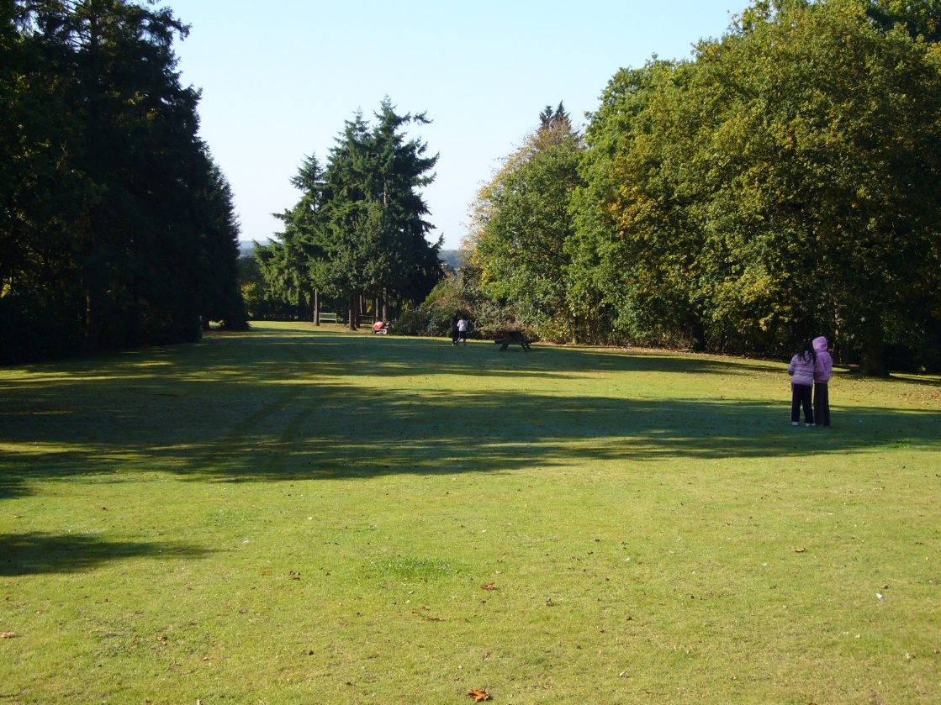
Is it safe??
Aldersbrook Primary School will be the only group on site throughout the weekend stay. The grounds are secure and site is locked at night.
Staff from the school and Fair Play House will accompany children around the site and grounds at all times.

Slide 11
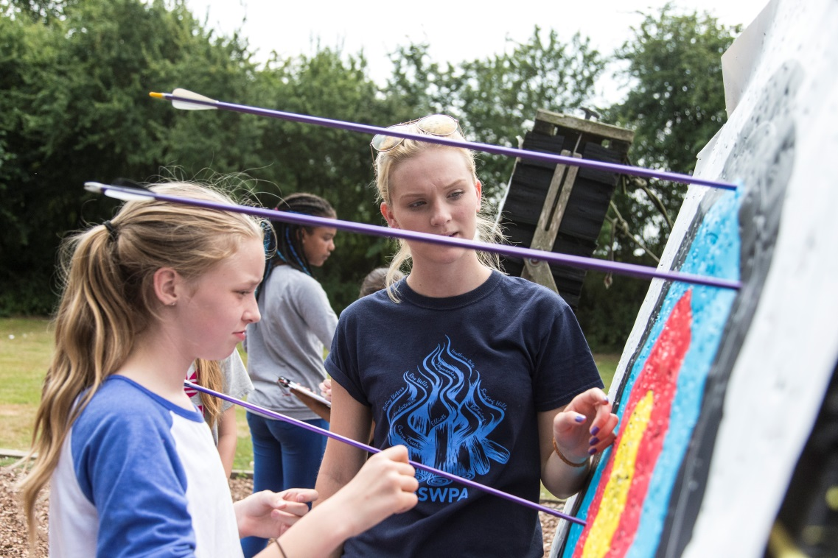
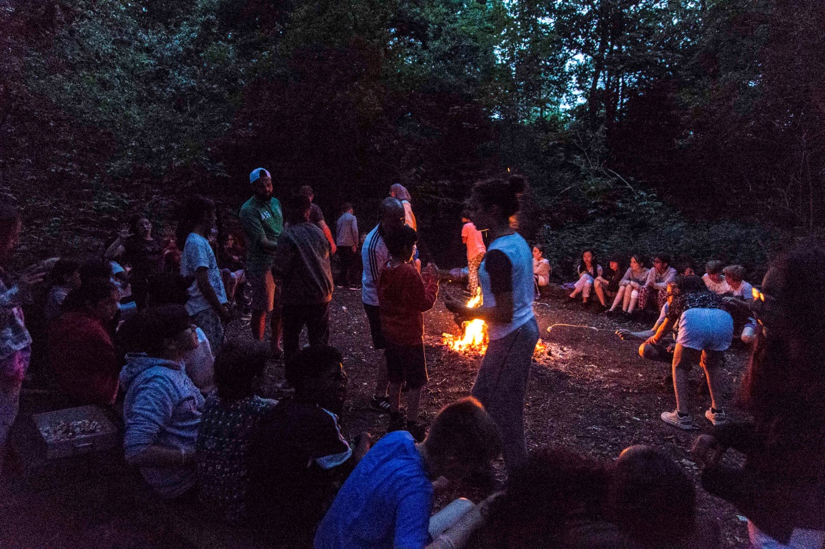
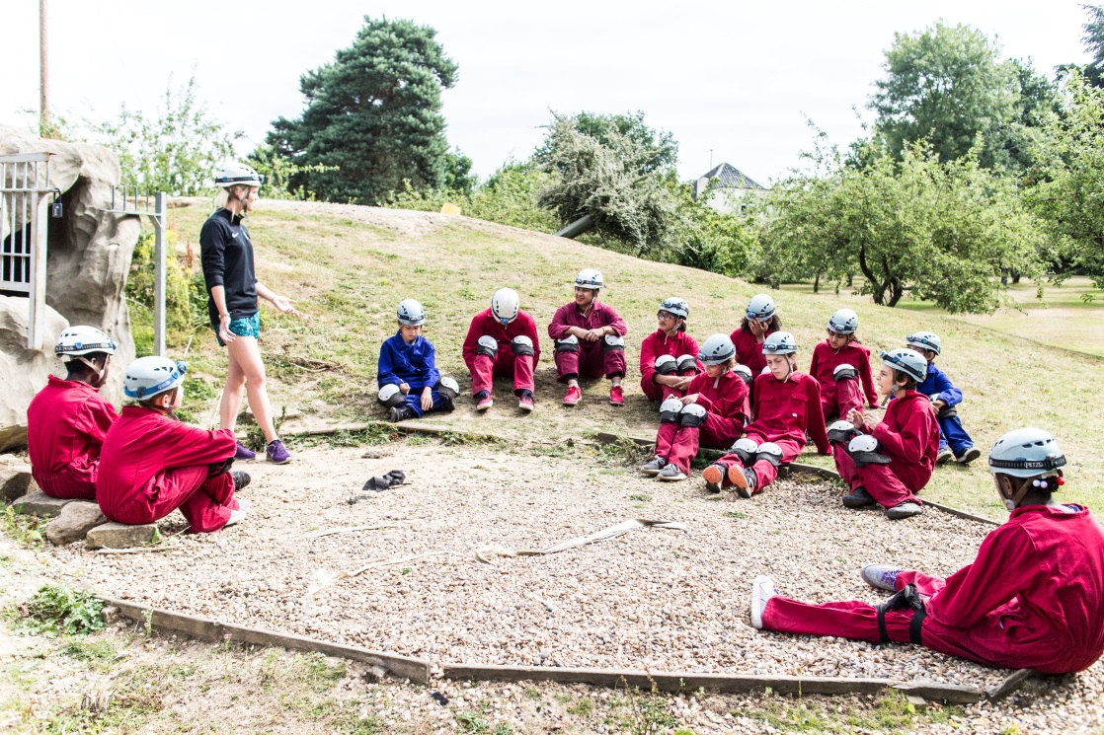
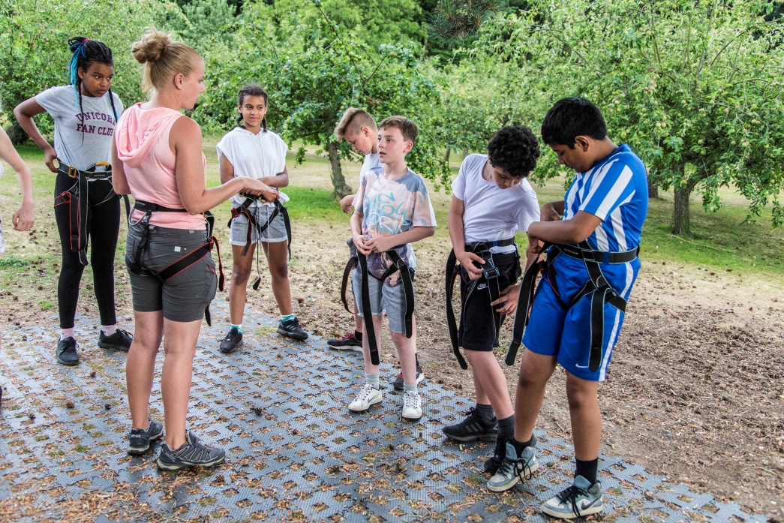

Slide 12
Which teachers are going?
Ms Brown
Mr Griffin
Mr Islam
Mr Gibson
Mrs Mc Dermott
Fairplay House staff (6)

Slide 13
Payment Information
Deposit taken from 17th March 2024 at 7pm
All of the remaining balance to be paid by 2nd May 2025
All payments via Arbor Parent Portal

Slide 14
‘Information and Consent Form’
Please complete this form in detail to ensure that all your child’s medical needs are included.
We cannot take any medication that you have not listed on the form. All medication must be prescribed by a GP, with a clear dosage label attached.
So if your child suffers from hayfever please include this on the form.
ALL medication will be administered by Mr Gibson. Please submit all medication with your child's name clearly on it.
All medication must be in date.
All medication MUST be passed to the school office by:
Wednesday 2nd July. No Medication can be accepted after this date as we have to log every item, box and make ready to transport along with completing the ‘when to administer’ form.

Slide 15
What food will my child eat?
All diets catered for:
Pescatarian
Halal
Vegetarian
Vegan
Allergies

Slide 16
FAQ?
Rooms for boys/ girls
How much spending money can I bring?
Sun cream
Appropriate clothing
Age appropriate toiletries

Slide 17
Any questions?
If you have a personal issue you would like to talk about, please see your child’s teacher and we will try as far as possible to help solve any issues.
Thank you

