Slide 1

Developing
GROWTH MINDSETS
Based on Carol Dweck’s ground-breaking work.
Notes:
1

Slide 2
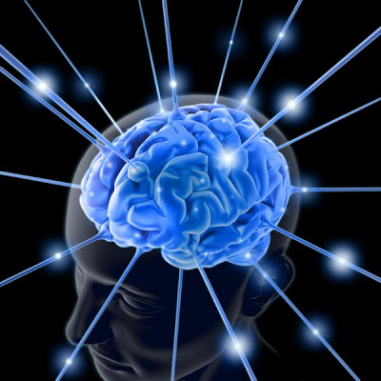
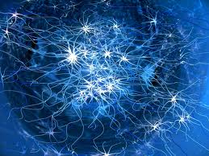
What is intelligence?
Is intelligence inherited ?
Is it harder to learn new things
as you get older?
Do some people have natural abilities that make learning some things easier for them?
Can intelligence be measured?
Notes:
Activity 1: Carousel of questions,each group answers and reviews each question, prepares an answer to their original question; this is the existing viewpoint of the room.
2

Slide 3
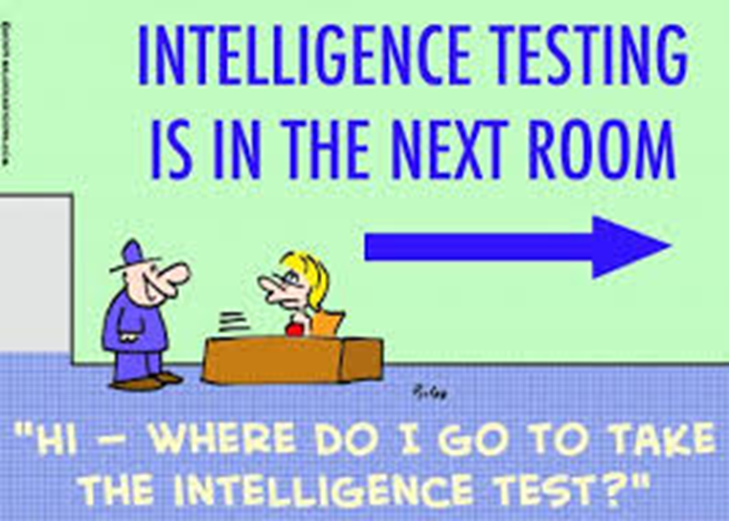
Fluid Intelligence (Gf): Refers to reasoning, seriation, sorting, and classifying abilities
Crystallized Intelligence (Gc): Refers to achievement and knowledge that results from acculturation
Visual Processing (Gv): Refers to the ability to accurately perceive/interpret spatial information and visually and mentally manipulate figures
Auditory Processing (Ga): Refers to the ability to listen and respond appropriately to auditory information
Short-Term Memory (Gsm): Refers to immediate awareness, alertness, and retrieval of recently learned information
Long-Term Storage and Retrieval (Glr): Refers to the ability to retrieve information from long-term storage
Processing Speed (Gs): Refers to the ability to quickly and efficiently respond to simple tasks
Decision Speed (Gt): Refers to the ability to provide speeded responses to tasks of slight or moderate difficulty
Quantitative Knowledge
Alfred Binet,
attention, memory and problem-solving.
Wechsler
verbal comprehension, perceptual reasoning, working memory and processing speed.
Howard Gardner
Cattell-Horn-Carroll
visual-spatial
interpersonal
verbal-linguistic
musical
bodily-kinaesthetic
intrapersonal
logical-mathematical
naturalistic
Robert Sternberg
analytical (problem solving)
critical (using past experiences and current
skills to support new learning)
practical ( adapting to changes)
Notes:
3

Slide 4
What do we think now?
Focusing on intelligence or ability leads to children being grouped in limiting ways.
The focus should not be on intelligence or ability but on learning and progress.
Character has a great impact on learning.
Learning without limits!

Slide 5
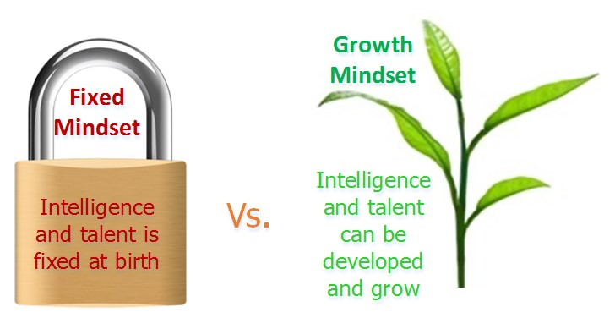
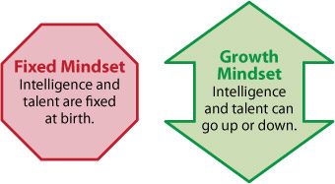
Professor Carol Dweck
We all have internalised theories of intelligence (mindsets)
Fixed Mindset
Growth Mindset
Belief that intelligence is something you are born with. Can’t change it much. | Belief that intelligence is malleable and can develop. Success takes effort and persistence, learning from mistakes and challenges.
Notes:
5

Slide 6
Approaches to Learning:
Fixed Mindset | Growth Mindset
Intelligence is a fixed trait & can’t change much | Intelligence can be increased through practice
Focus on performance | Focus on learning
Failure and/or effort perceived as being a sign of low ability | Not threatened by hard work or failure
Choose activities to maximise performance (easy ones to feel clever) | Seek new challenges for a sense of achievement
Don’t recover well from setbacks | Mistakes are perceived as a good thing as they help the learning processes
Decrease efforts, withdraw or consider cheating (self-protection) | View effort and persistence as a necessary part of success
Helplessness orientation | Mastery orientation
Notes:
6

Slide 7
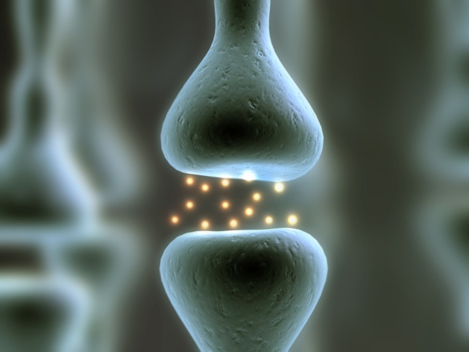

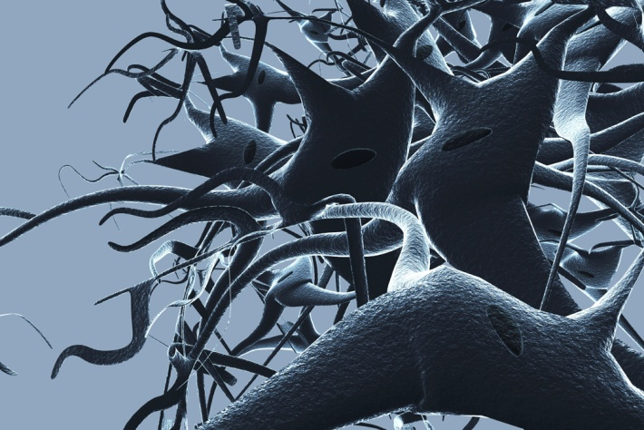
Evidence from Neuroscience
Plasticity
Neurones in the brain transmit information through connections called synapses.
The more we keep our brains active through learning new information, the more connections the brain makes.
Notes:
7

Slide 8
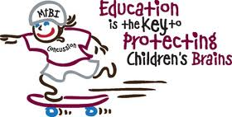
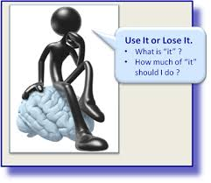
Children’s brains grow rapidly
as they are learning all the time.
As such, their brains are very
malleable and new connections
are developing all the time.
However, plasticity continues to occur throughout the life span. Recent research suggests that it is our ability to filter out irrelevant details that diminishes rather than the brain’s ability to learn new things. https://news.brown.edu/articles/2014/11/irrelevant
Notes:
8

Slide 9
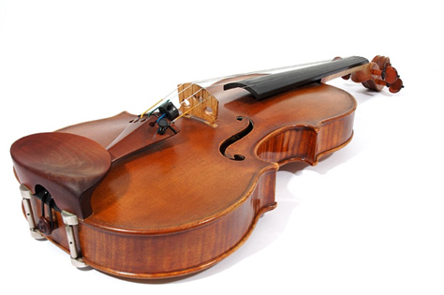
Research evidence
““The Violin Study”
Ericsson, Krampe, & Tesch-Romer (2007)
  Investigated the causes of outstanding performance in violinists from the Music Academy of Berlin in Germany
Age started playing?
Musical Parents?
Teachers Qualifications?
Other instruments played?
Students were divided into three groups:
  The outstanding group
  The extremely good group
  The least able group
Notes:
9

Slide 10
So what made the difference?
PRACTICE
By the age of 20, the outstanding group had spent an average of 10000 hours practising- 2000 more hours than the extremely good group, and 6000 more than the least able group.
There were no exceptions to this pattern.
What does this tell us about “natural” talent?

Slide 11
So how can you support your child to have a Growth Mindset?

Slide 12
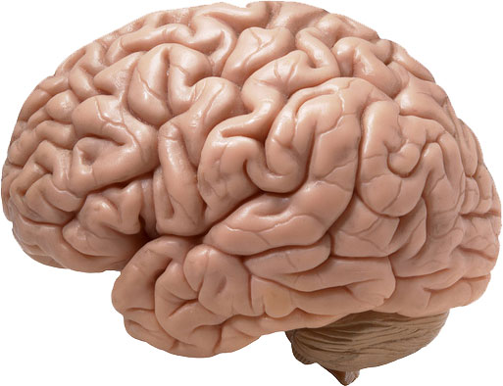
Start with the brain
Spark interest by showing some of the clever things that the brain can do.
Explain how the brain works in simple terms.
Emphasise the possibility of making new connections.

Slide 13
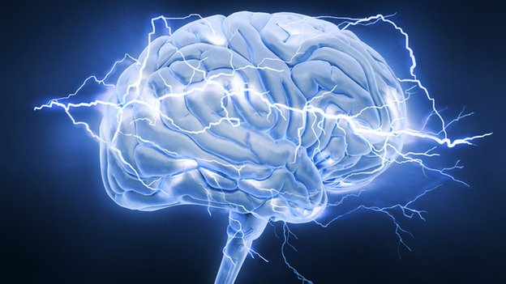
The Brain
Children love to learn about the brain and how clever it is.
Sound 1
Sound 2
From
http://www.mrc-cbu.cam.ac.uk/people/matt-davis/personal/sine-wave-speech/

Slide 14
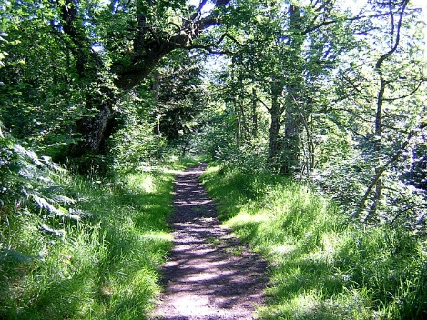
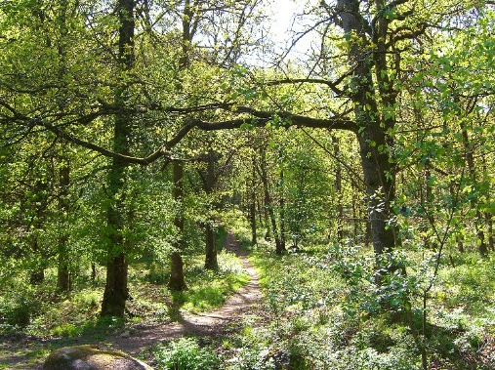
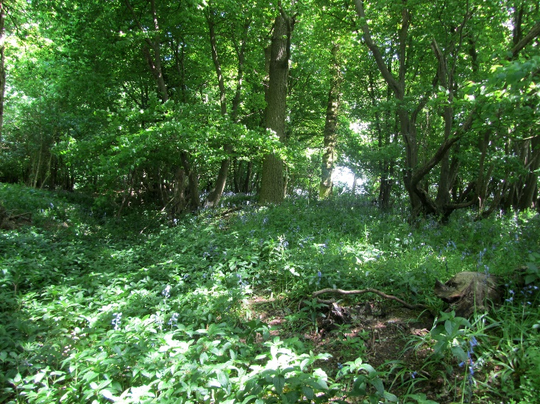
    An effective analogy is of the brain as a forest, the electrical pathways as forest pathways.
The more well-trodden paths are easier to walk along, and are therefore more used.
Some pathways have been used a bit, and are fairly easy to walk along.
Less-trodden paths are covered in brambles and nettles. But they can be cleared and made easier to walk along

Slide 15
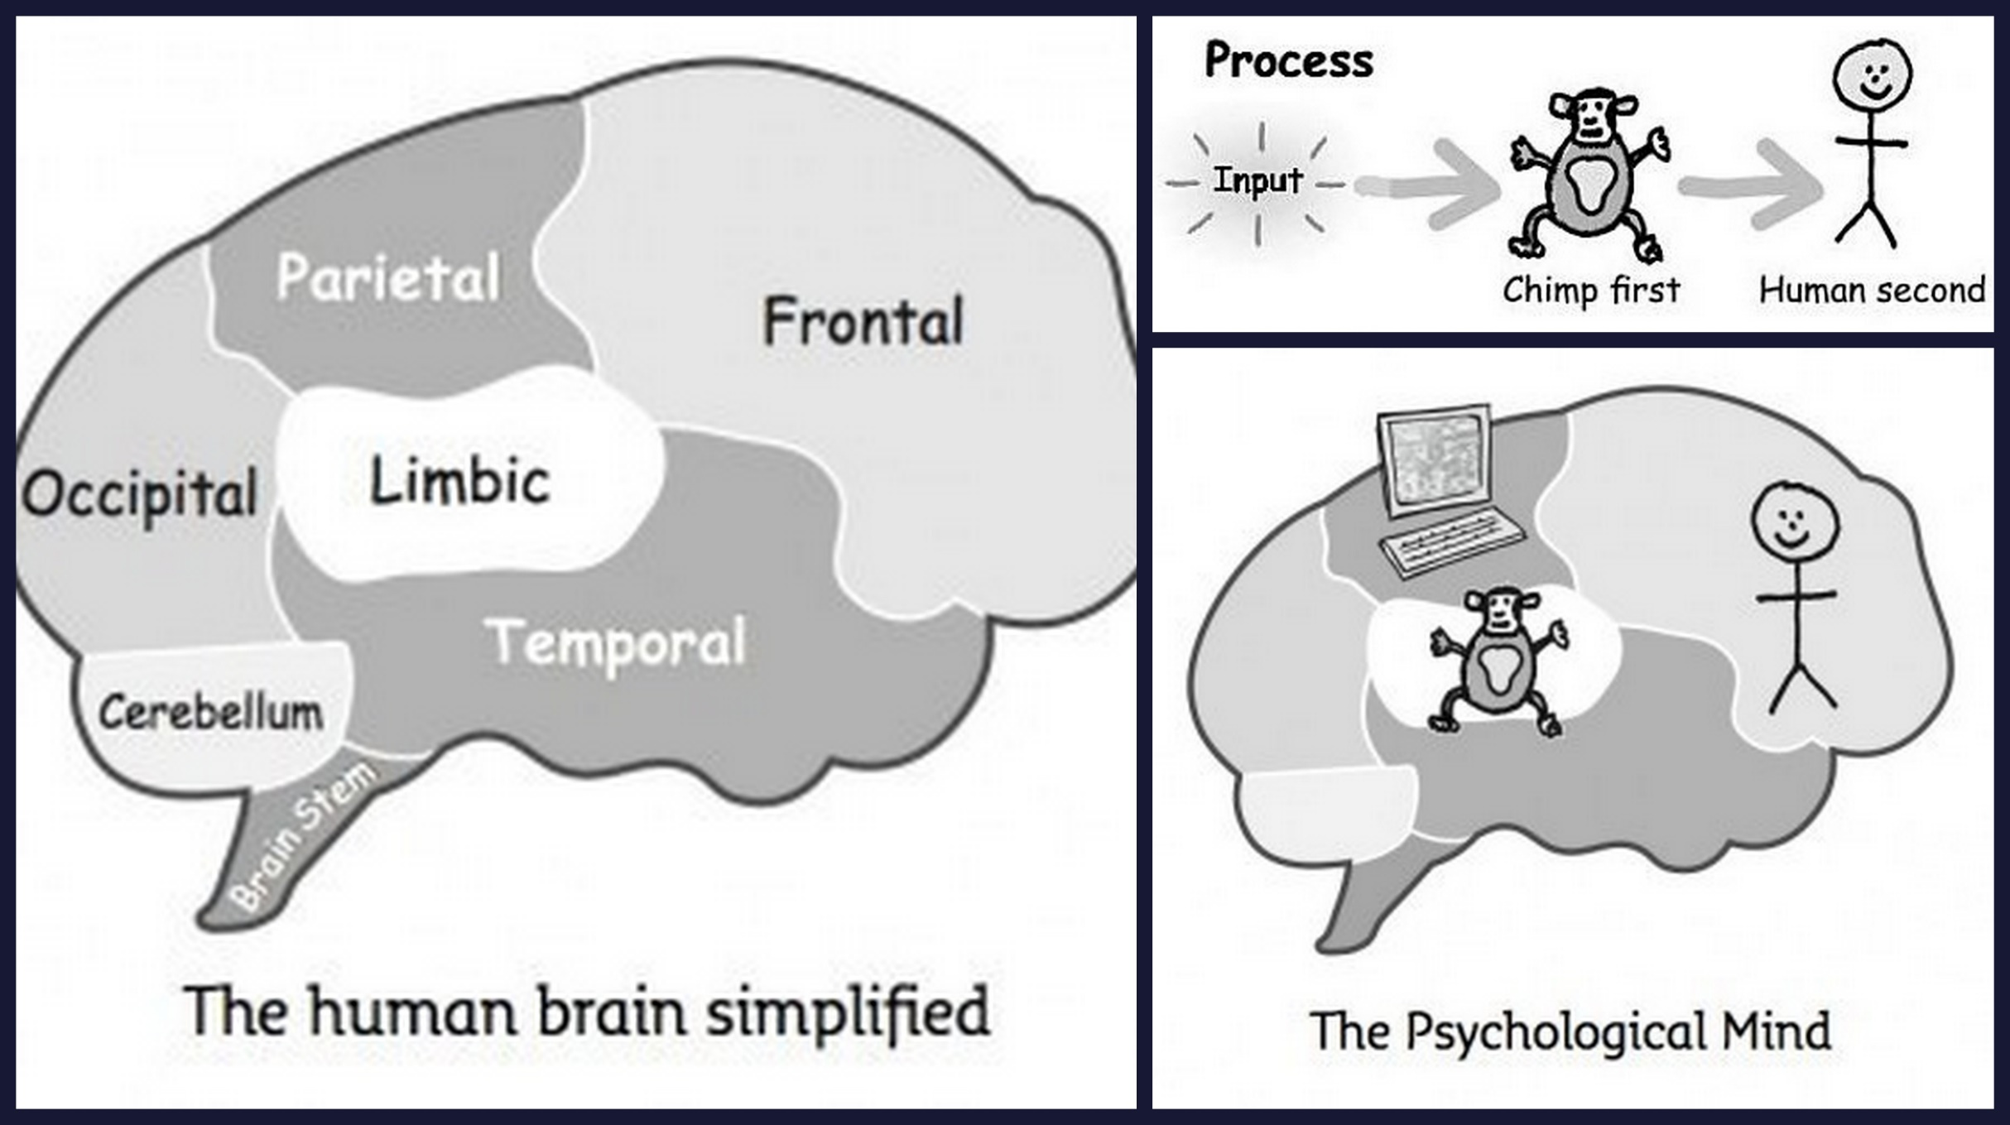
Internal voices
Ideas from Dr Steve Peters “The Chimp Paradox”
Notes:
15

Slide 16
Internal Voices
Manage emotional responses
Recognise your “chimp” voice
Use growth mindset language for “self talk”
I can’t do this
… yet!

Slide 17

Celebrating misstakes
The fear of making mistakes and associated shame and embarrassment can stop pupils from trying.
Don’t let pupils blame others for failure and mistakes.
Make the most of their mistakes: celebrate mistakes!
Notes:
17

Slide 18

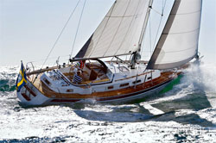
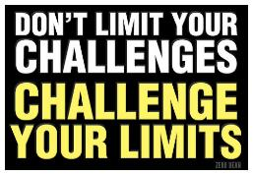
Model the behaviour you want
“I’m no good at swimming.”
“Spelling was never my thing, my talent was in maths.”
Don’t describe yourself with fixed mindset language.
Talk about the challenges you have faced, how you succeeded and your new goals.
Or talk about how you have not achieved something because you didn’t stick at it, or haven’t stuck at it YET.
Notes:
18

Slide 19




The Language of Praise
We may encourage Fixed Mindsets without realising
Negatively …
“Oh dear, you’re not good at this, are you?”
“Never mind, you are more creative than scientific.”
“That’s too hard for you. Try an easier one.”
“You can’t be good at everything.”
and Positively:
  “You are such a smart boy!”
  “You are really good at maths.”
“This is definitely one of your talents.”
“You have always been good at this.”
3/10
Notes:
19

Slide 20

Person/ability focused feedback causes...
…temporarily high self-esteem, but the longer term implications are:
  when they fail or are challenged, they don’t know how to put it right, and instead they re-evaluate their ability.
  their self-esteem is insecure and they are easily stressed.
  they avoid difficult tasks in the future to avoid failure.
  over time, their attainment drops.
Notes:
20

Slide 21

Growth feedback
Process praise
Effort
Strategy
Interpret setbacks as lack of effort, persistence or as the result of inappropriate strategies
Task praise
What is better/worse than the last attempt
What is/is not good, realistic, neat, correct etc.
Notes:
21

Slide 22
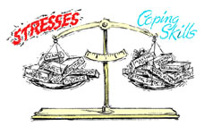
Children praised this way...
develop coping skills.
  When they are challenged or fail they know what to do:
      Work harder
      Try again
      Try a different strategy
  They can be resilient, and no longer need to re-evaluate their ability.
  Their self-esteem remains stable.
  They do not need to avoid challenge or tasks that they have failed at in the past.
  Know that difficulties are inevitable.
Notes:
22

Slide 23
Coping with difficulties
What are our emotional responses to difficulties when learning?
FIGHT FLIGHT FREEZE
FIRST have a strong growth mindset.
NEXT be kind to yourself (don’t beat yourself up for failures)
THEN, what does “fight” mean in a learning context?
Get help RESOURCEFULNESS
Try a different strategy OPEN-MINDEDNESS, ADAPTABILITY
Try again PERSISTENCE, RESILIENCE

Slide 24
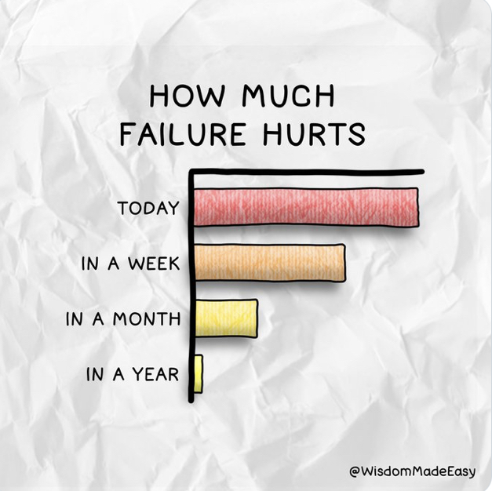
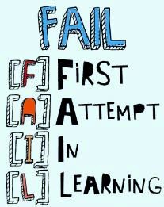
Resilience
3 traits of resilient people
Notes:
24

Slide 25
1, Know that difficult times happen
2, Good at choosing where they select their attention. They accept what they can change and accept those that they can’t. They can tune in to the good.
3, Is it helping or harming?

Slide 26




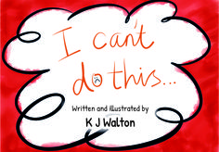
Books for children
Notes:
26

Slide 27
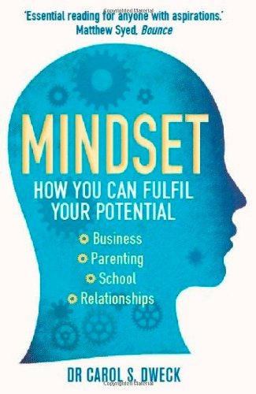

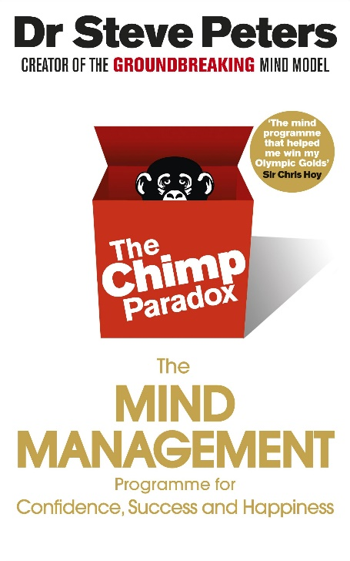
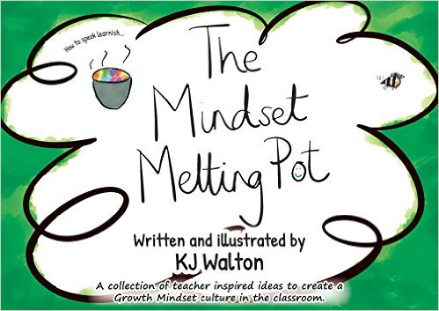

Reading
Links
http://www.port.ac.uk/department-of-psychology/community-collaboration/growing-learners/
Links

