Slide 1
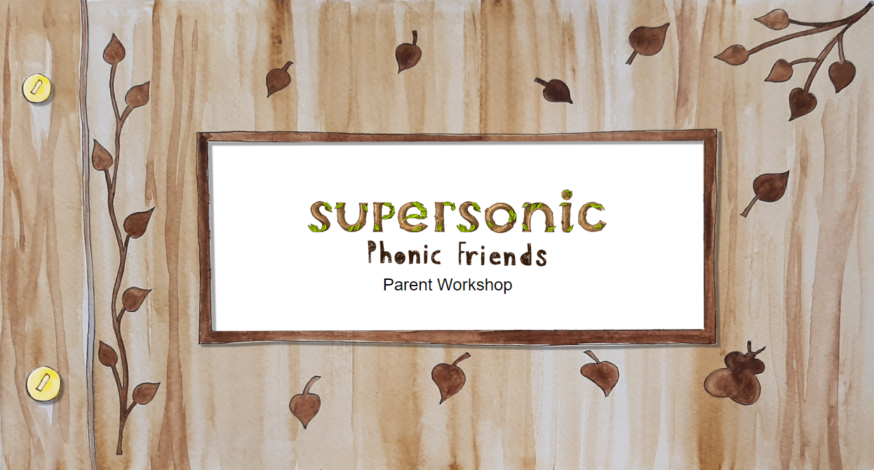

Slide 2
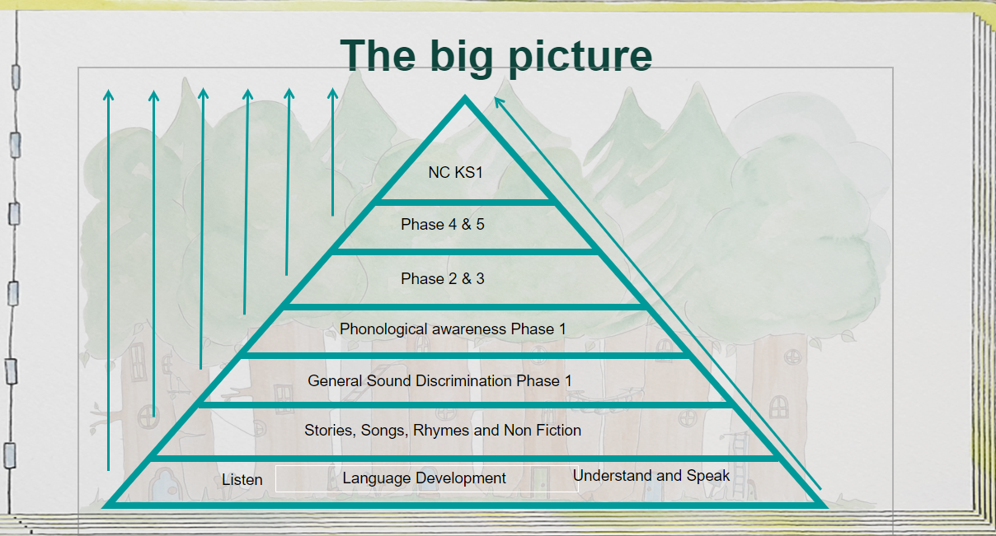

Slide 3
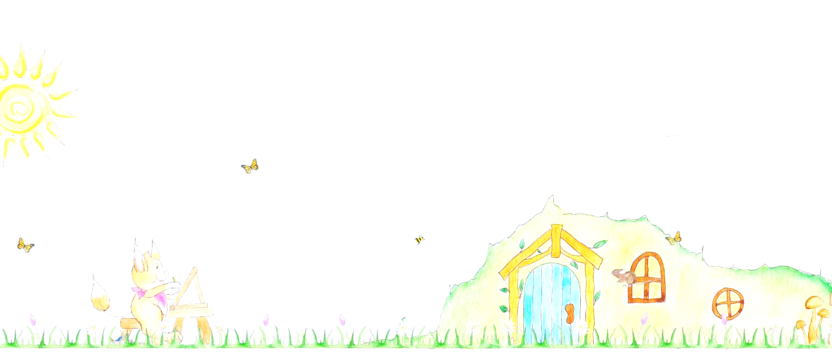
What is Phonics?
We use Letters and Sounds programme which is recommended by the DFE.
We use the Phased 1-5 systematic approach.
In EYFS we focus heavily on the ability to listen to sounds in words.
Recognising the spelling for the sounds in words.
Building words
Writing words using our sounds

Slide 4
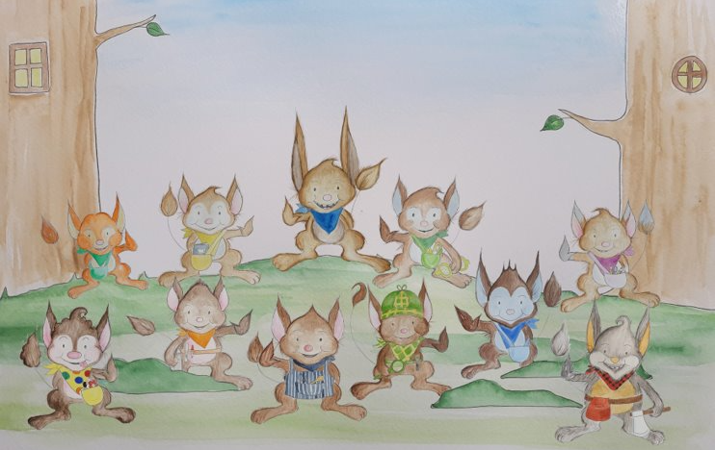
The characters

Slide 5
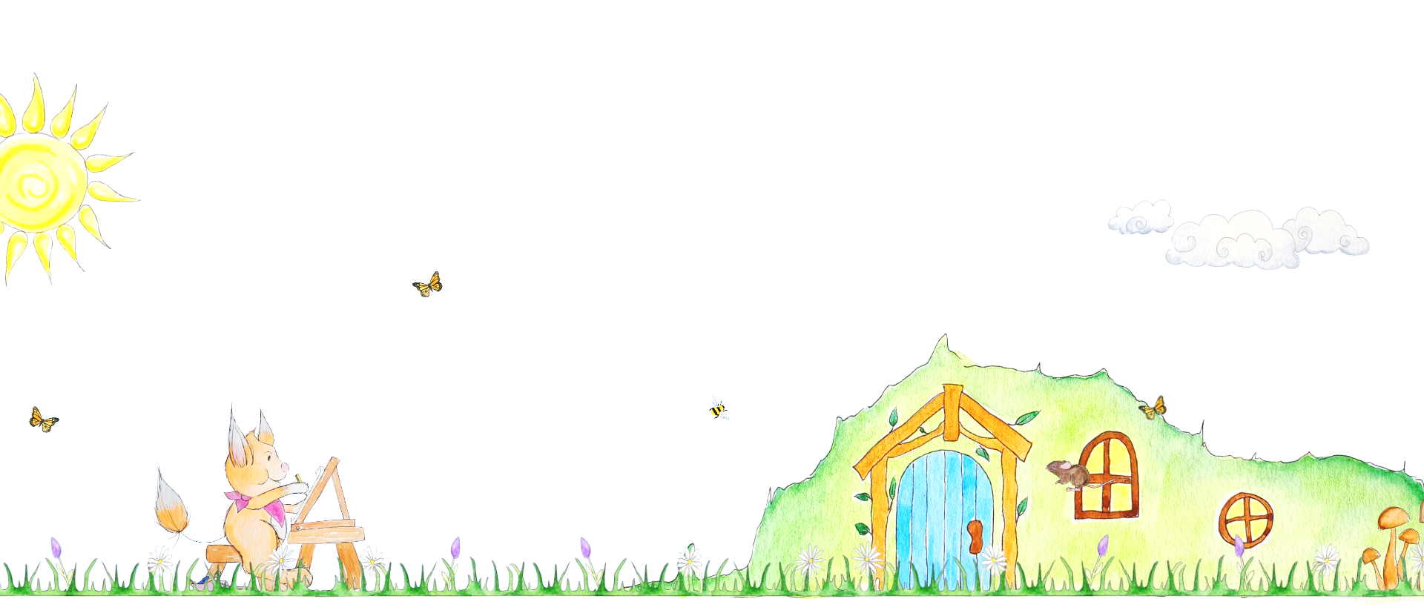
Firm Foundations in Phonics- Phase 1
General sound Discrimination The Strands
Aspect 1 Environment sounds Tuning into sounds
(auditory discrimination)
Aspect 2 Instrumental sounds Listening and remembering sounds
(auditory memory and sequencing)
Aspect 3 Body Percussion Talking about sounds
(developing vocabulary and language comprehension)

Slide 6
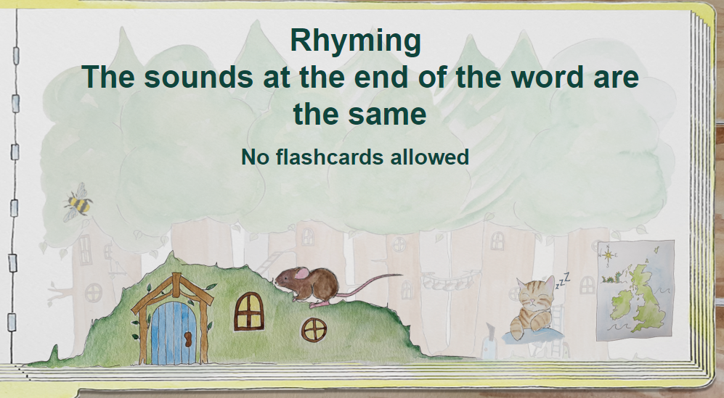
Rhyming
The sounds at the end of the word are the same.

Slide 7
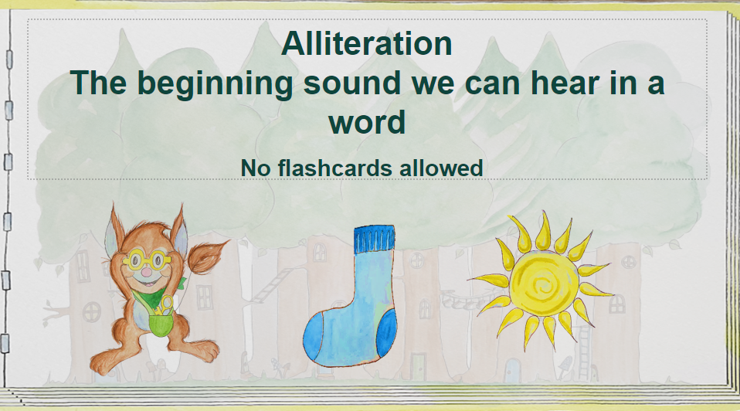
Alliteration
The beginning sound we can hear in a word.

Slide 8
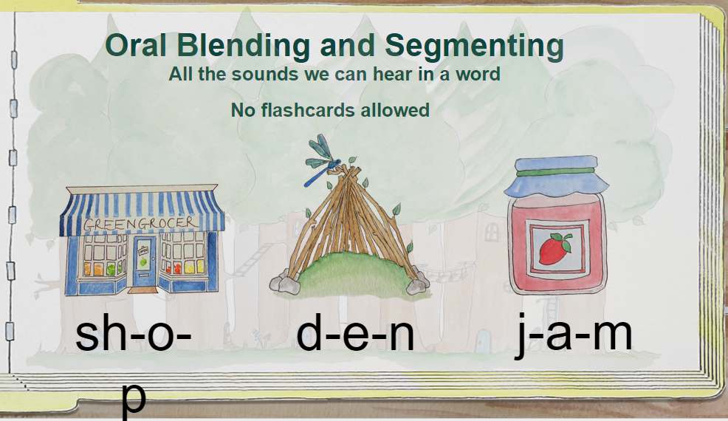

Oral blending and Segmenting
All the sounds we can hear in a word.
Sh-o-p
d-e-n
j-a-m

Slide 9
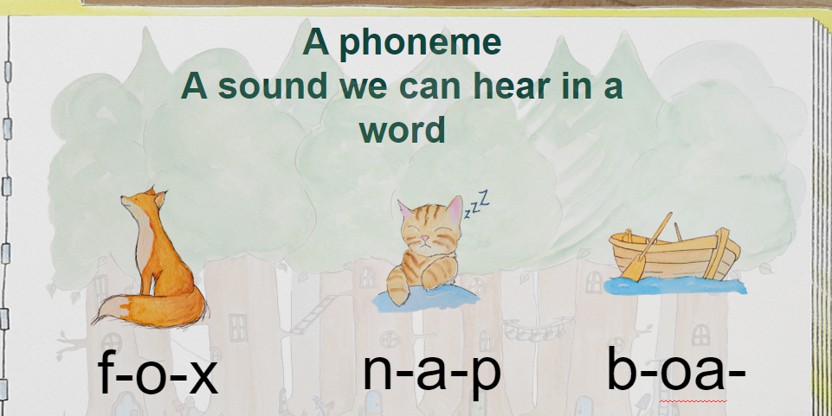
A phoneme
A sound we can hear in a word
f-o-x
n-a-p
b-oa-t

Slide 10
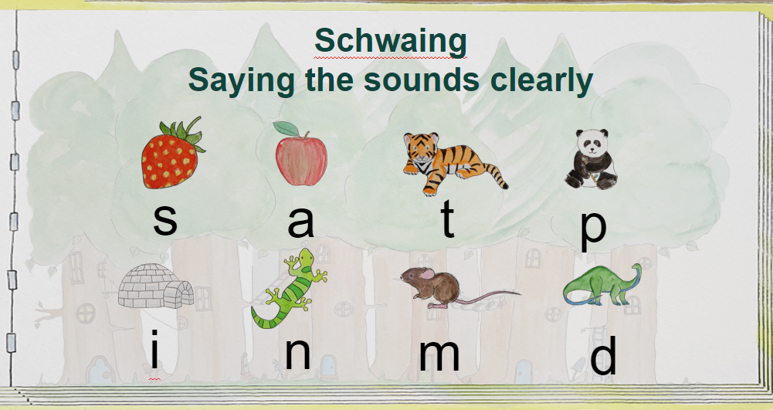
Pronunciation of sounds
Pronouncing the sounds accurately

Slide 11
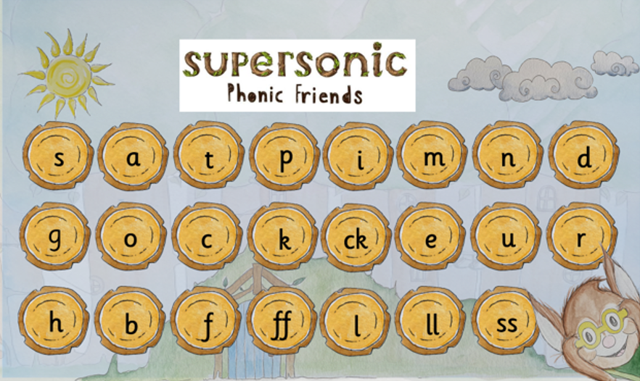
A grapheme
The spelling we can see

Slide 12
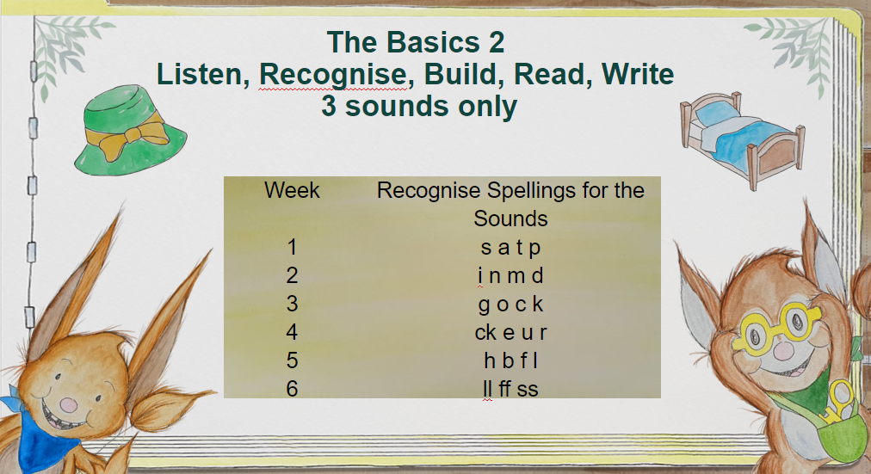
The Basics 2
Listen, Recognise, Build, Read, Write 3 sounds only

Slide 13
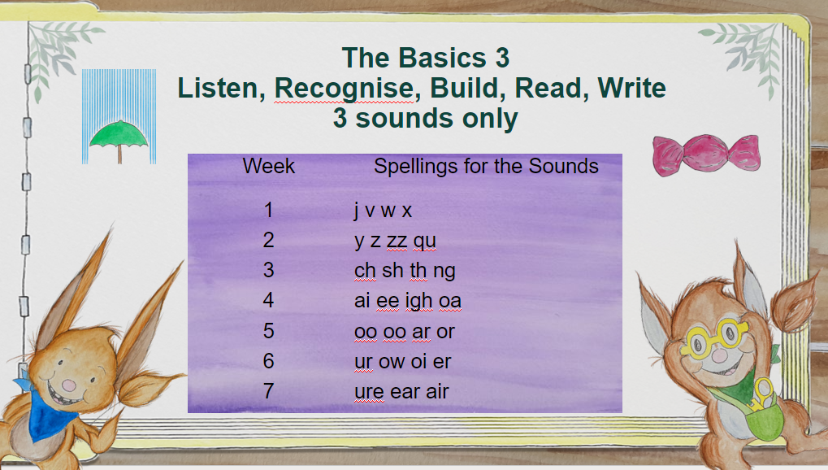
The Basics 3
Listen, Recognise, Build, Read, Write 3 sounds only

Slide 14
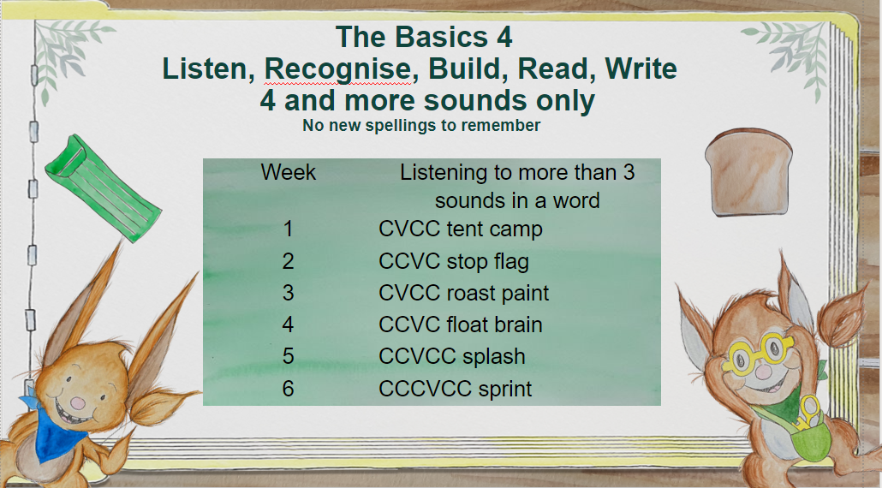
The Basics 4
Listen, Recognise, Build, Read, Write
4 and more sounds only (no more new spellings to remember)

Slide 15
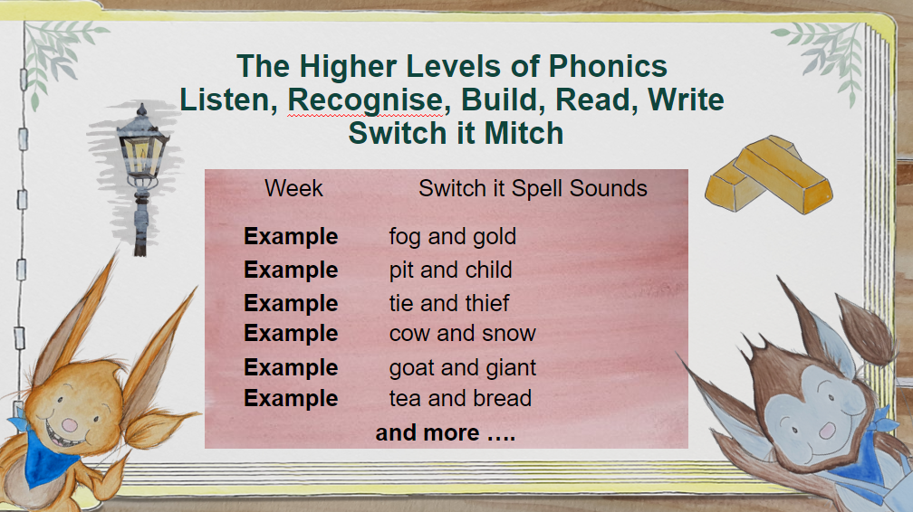
The higher levels of Phonics
Listen, Recognise, Build, Read, Write
Switch it Mitch

