Slide 1


Aldersbrook Primary School
Anti-Bullying Week 2021
Theme: One Kind Word

Slide 2
What is bullying?
Bullying is behaviour by an individual or group, repeated over time, that intentionally hurts another individual or group either physically or emotionally.
REPETITIVE
PURPOSELY hurting
IMBALANCE of power

Slide 3
What are the types of bullying?
(Peer on Peer abuse)
Physical (when someone pushes, hit or harm a child in any way physically)
Name calling (using insults and offensive nicknames)
Social (leaving out, fake rumours, damaging a person’s reputation, excluding others, online and offline)
Cyberbullying (being bullied online, via social networks, apps, messenger and phones)
Sexual (unwanted sexual advances, pressurised to do sexual things, sexting, sexuality, spreading sexual rumours, upskirting)

Slide 4
How does bullying differ from banter/teasing?
There is a deliberate intention to hurt or humiliate
There is a power imbalance
It is usually persistent
Several Times On Purpose

Slide 5
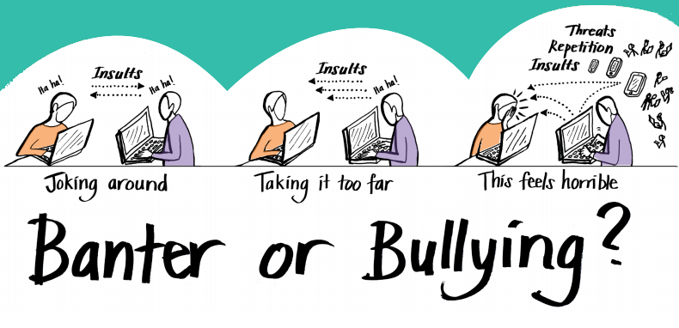
Bullying or Banter?
a clear statement that abuse is abuse and should never be tolerated or passed off as “banter”, “just having a laugh” or “part of growing up”.

Slide 6
Friends fall out!
We sometimes describe this as relational conflict
Children fall out and need to learn how to resolve conflicts
Children need the confidence to deal with conflicts and to develop resilence
But it can lead to bullying………..

Slide 7
e.g. 2 friends fall out…
No imbalance of power
Insult
Insult
Insult
Imbalance of power through repetition, threat, etc.
Insult
Stop it!
Insult
Clear imbalance of power
Insult
Stop it! All of you! It’s not true!!
Insult
Insult
Rumour spread
Notes:
This slide explains the “imbalance of power”: this slide explores the issues further.
You might want to discuss some scenarios which would involve an imbalance of power.

Slide 8


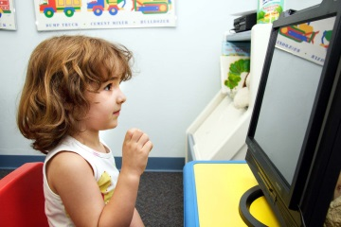
What is Cyber-bullying?
In what ways do you think cyberbullying
can happen?
receiving nasty or inappropriate messages
someone posting nasty or inappropriate photos of someone online
getting nasty or inappropriate on Online games e.g. Minecraft
prank phone calls
nasty comments on social media like Facebook, Twitter, Whatsapp, TikTok, within chat rooms or in a messaging app

Slide 9
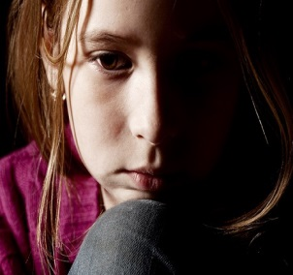
How to spot signs a child is being bullied
Coming home with cuts and bruises (Self-harm)
Losing belongings
Feeling anxious about going to school
Wanting to change their journey or journey time to school.
Reluctant to go to school
Doing less well with their school work
Being aggressive towards siblings, and family members
Difficulty sleeping
Developing an eating disorder
Becoming withdrawn socially and reluctant to go out
Avoiding social media or messenger

Slide 10
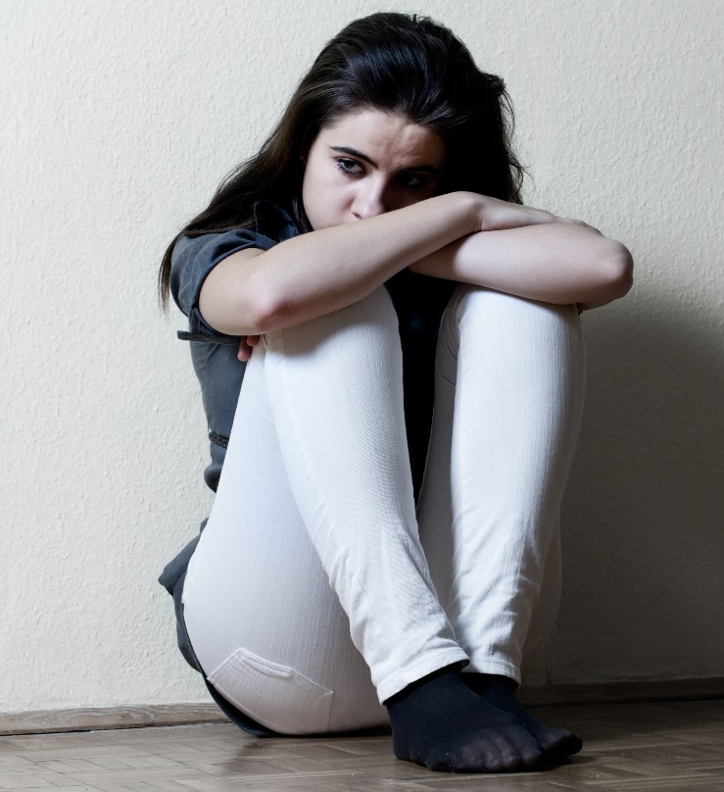
How a child might react if they are being bullied
Depressed
Anxious
Isolated
Withdrawn
Suicidal
Humiliated
Low
Upset
Angry
Frustrated
Blame themselves
Notes:
A person might bottle up their emotions and try not to let it show to their friends or family. It can be hard for someone to feel all those things and try to keep it to themselves and often as a result their behaviour may change. They may show their feelings in other ways and know the signs to look out is really important. In extreme cases, a person may feel so low they may attempt to or actually take their life. This is sadly a reality for some families who have lost a loved one through bullying. Encourage the young people to work in groups to find other ways of how it might make a person react.

Slide 11






The scars bullying can leave - task
Notes:
Give the Parents 2 pieces of paper and ask them to keep one and screw up the other one as tightly as they can. Once they have done this, ask them to unravel the screwed up piece of paper and try to straighten it out the best they can. Then ask the parents to hold up the two pieces of paper and compare the differences. Ask them to tell you what the differences are. Then you can reiterate to them that no matter how much you try to straighten things out, the scars of bullying remain.

Slide 12
What to do if you feel your child is being bullied
Report the bullying to a teacher or someone at school you feel safe with- Senior Leadership Team, ELSA, Parent Support
Tell a parent or a family member
Encourage our children to be assertive with the bully but not aggressive
Ignore it and walk away with no reaction
Keep a diary

Slide 13
Tips for talking to your child about being bullied
What did you do at school today?
Who did you play with?
What game did you play?
Did you enjoy it?
Would you have liked to play with someone else or different games?
Is there anyone that you don’t like at school? Why?
Are you looking forward to going to school tomorrow?

Slide 14
If your child finds it hard to talk about being bullied or has communication difficulties, you could:
Draw pictures of your child’s day or ask them to draw what has happened during their day. For example pictures of them playing at break etc
Use pictures of faces expressing feelings.

Slide 15
Our Stance on bullying
Anti-Bullying Policy
Zero tolerance
PSHE
Values of Education
Celebration Assemblies
Every child is valued and provided for

Slide 16
Useful Websites and Contacts
Kidspace.org.uk
Childline- (0800 11 11) Calls are free and confidential
KIDSMART-Learning how to be a SMART surfer online
Bullying Online-Advice and support for parents
https://anti-bullyingalliance.org.uk/anti-bullying-week

Slide 17
Any questions?

